Slide 1
C H A P T E R 6
Files and Exceptions

Slide 2
Topics
Introduction to File Input and Output
Using Loops to Process Files
Processing Records
Exceptions

Slide 3
Introduction to File Input and Output
For program to retain data between the times it is run, you must save the data
Data is saved to a file, typically on computer disk
Saved data can be retrieved and used at a later time
“Writing data to”: saving data on a file
Output file: a file that data is written to

Slide 4
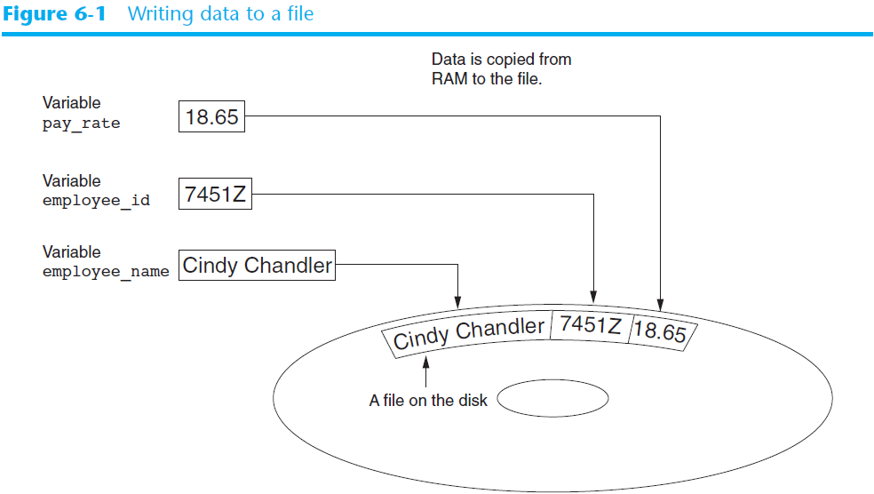

Slide 5
Introduction to File Input and Output (cont’d.)
“Reading data from”: process of retrieving data from a file
Input file: a file from which data is read
Three steps when a program uses a file
Open the file
Process the file
Close the file

Slide 6
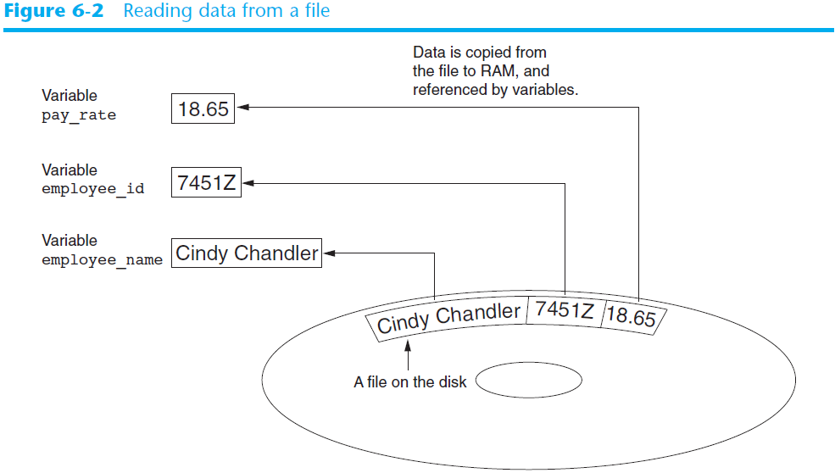

Slide 7
Types of Files and File Access Methods
In general, two types of files
Text file: contains data that has been encoded as text
Binary file: contains data that has not been converted to text
Two ways to access data stored in file
Sequential access: file read sequentially from beginning to end, can’t skip ahead
Direct access: can jump directly to any piece of data in the file

Slide 8
Filenames and File Objects
Filename extensions: short sequences of characters that appear at the end of a filename preceded by a period
Extension indicates type of data stored in the file
File object: object associated with a specific file
Provides a way for a program to work with the file: file object referenced by a variable

Slide 9
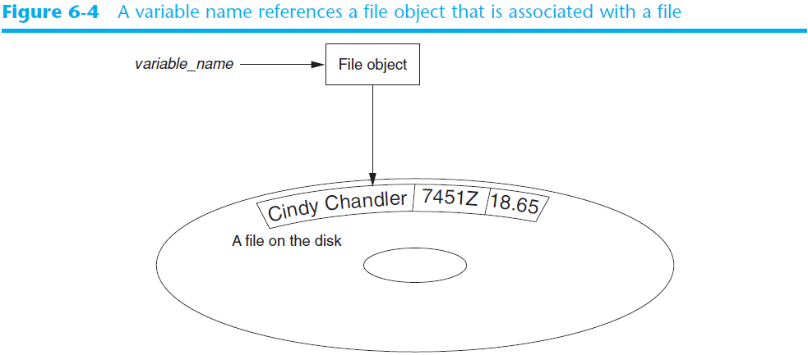
Filenames and File Objects (cont’d.)

Slide 10

Opening a File
open function: used to open a file
Creates a file object and associates it with a file on the disk
General format:
file_object = open(filename, mode)
Mode: string specifying how the file will be opened
Example: reading only ('r'), writing ('w'), and appending ('a')

Slide 11
Specifying the Location of a File
If open function receives a filename that does not contain a path, assumes that file is in same directory as program
If program is running and file is created, it is created in the same directory as the program
Can specify alternative path and file name in the open function argument
Prefix the path string literal with the letter r

Slide 12
Writing Data to a File
Method: a function that belongs to an object
Performs operations using that object
File object’s write method used to write data to the file
Format: file_variable.write(string)
File should be closed using file object close method
Format: file_variable.close()

Slide 13
# This program writes three lines of data
# to a file.
def main():
# Open a file named philosophers.txt.
outfile = open('philosophers.txt', 'w')
# Write the names of three philosphers
# to the file.
outfile.write('John Locke\n')
outfile.write('David Hume\n')
outfile.write('Edmund Burke\n')
# Close the file.
outfile.close()
# Call the main function.
main()
Notes:
寫一個檔案印99乘法表

Slide 14
Reading Data From a File
read method: file object method that reads entire file contents into memory
Only works if file has been opened for reading
Contents returned as a string
readline method: file object method that reads a line from the file
Line returned as a string, including '\n'
Read position: marks the location of the next item to be read from a file

Slide 15
# This program reads and displays the contents
# of the philosophers.txt file.
def main():
# Open a file named philosophers.txt.
infile = open('philosophers.txt', 'r')
# Read the file's contents.
file_contents = infile.read() # read all file content
# Close the file.
infile.close()
# Print the data that was read into
# memory.
print(file_contents)
# Call the main function.
main()

Slide 16
# This program reads the contents of the
# philosophers.txt file one line at a time.
def main():
# Open a file named philosophers.txt.
infile = open('philosophers.txt', 'r')
# Read three lines from the file
line1 = infile.readline()
line2 = infile.readline()
line3 = infile.readline()
# Close the file.
infile.close()
# Print the data that was read into
# memory.
print(line1)
print(line2)
print(line3)
# Call the main function.
main()
# read line by line

Slide 17
Concatenating a Newline to and Stripping it From a String
In most cases, data items written to a file are values referenced by variables
Usually necessary to concatenate a '\n' to data before writing it
Carried out using the + operator in the argument of the write method

Slide 18
# This program gets three names from the user
# and writes them to a file.
def main():
# Get three names.
print('Enter the names of three friends.')
name1 = input('Friend #1: ')
name2 = input('Friend #2: ')
name3 = input('Friend #3: ')
# Open a file named friends.txt.
myfile = open('friends.txt', 'w')
# Write the names to the file.
myfile.write(name1 + '\n')
myfile.write(name2 + '\n')
myfile.write(name3 + '\n')
# Close the file.
myfile.close()
print('The names were written to friends.txt.')
main()

Slide 19
Concatenating a Newline to and Stripping it From a String
In many cases need to remove '\n' from string after it is read from a file
rstrip method: string method that strips specific characters from end of the string

Slide 20
# This program reads the contents of the
# philosophers.txt file one line at a time.
def main():
# Open a file named philosophers.txt.
infile = open('philosophers.txt', 'r')
# Read three lines from the file
line1 = infile.readline()
line2 = infile.readline()
# Strip the \n from each string.
line1 = line1.rstrip('\n')
line2 = line2.rstrip('\n')
# Close the file.
infile.close()
# Print the data that was read into
# memory.
print(line1)
print(line2)
# Call the main function.
main()

Slide 21
Appending Data to an Existing File
When open file with 'w' mode, if the file already exists it is overwritten
To append data to a file use the 'a' mode
If file exists, it is not erased, and if it does not exist it is created
Data is written to the file at the end of the current contents

Slide 22
Writing and Reading Numeric Data
Numbers must be converted to strings before they are written to a file
str function: converts value to string
Number are read from a text file as strings
Must be converted to numeric type in order to perform mathematical operations
Use int and float functions to convert string to numeric value

Slide 23
# This program demonstrates how numbers
# must be converted to strings before they
# are written to a text file.
def main():
# Open a file for writing.
outfile = open('numbers.txt', 'w')
# Get three numbers from the user.
num1 = int(input('Enter a number: '))
num2 = int(input('Enter another number: '))
num3 = int(input('Enter another number: '))
# Write the numbers to the file.
outfile.write(str(num1) + '\n')
outfile.write(str(num2) + '\n')
outfile.write(str(num3) + '\n')
# Close the file.
outfile.close()
print('Data written to numbers.txt')
# Call the main function.
main()
outfile.write(“This is num1: {}\n”.format(num1))

Slide 24
def main():
# Open a file for reading.
infile = open('numbers.txt', 'r')
# Read three numbers from the file.
num1 = int(infile.readline())
num2 = int(infile.readline())
num3 = int(infile.readline())
# Close the file.
infile.close()
# Add the three numbers.
total = num1 + num2 + num3
# Display the numbers and their total.
print('The numbers are:', num1, num2, num3)
print('Their total is:', total)
# Call the main function.
main()
Notes:
寫~

Slide 25
Using Loops to Process Files
Files typically used to hold large amounts of data
Loop typically involved in reading from and writing to a file

Slide 26
def main():
# Get the number of days.
num_days = int(input('For how many days do ' + \
'you have sales? '))
# Open a new file named sales.txt.
sales_file = open('sales.txt', 'w')
# Get the amount of sales for each day and write
# it to the file.
for count in range(1, num_days + 1):
# Get the sales for a day.
sales = float(input('Enter the sales for day #' + \
str(count) + ': '))
# Write the sales amount to the file.
sales_file.write(str(sales) + '\n')
# Close the file.
sales_file.close()
print('Data written to sales.txt.')
# Call the main function.
main()

Slide 27
Using Loops to Process Files
Often the number of items stored in file is unknown
The readline method uses an empty string as a sentinel when end of file is reached
Can write a while loop with the condition
while line != ''

Slide 28
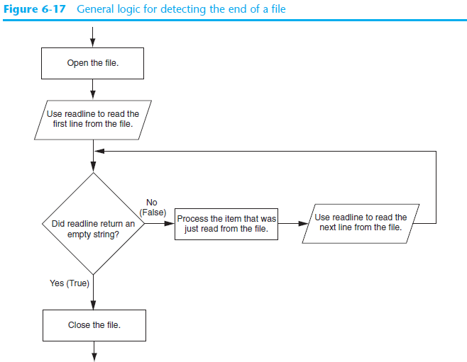

Slide 29
def main():
# Open the sales.txt file for reading.
sales_file = open('sales.txt', 'r')
# don't convert to a number yet. We still
# need to test for an empty string.
line = sales_file.readline()
while line != '':
# Convert line to a float.
amount = float(line)
# Format and display the amount.
print(format(amount, '.2f'))
# Read the next line.
line = sales_file.readline()
# Close the file.
sales_file.close()
# Call the main function.
main()

Slide 30
Using Python’s for Loop to Read Lines
Python allows the programmer to write a for loop that automatically reads lines in a file and stops when end of file is reached
Format: for line in file_object:
statements
The loop iterates once over each line in the file

Slide 31
# This program uses the for loop to read
# all of the values in the sales.txt file.
def main():
# Open the sales.txt file for reading.
sales_file = open('sales.txt', 'r')
# Read all the lines from the file.
for line in sales_file:
# Convert line to a float.
amount = float(line)
# Format and display the amount.
print(format(amount, '.2f'))
# Close the file.
sales_file.close()
# Call the main function.
main()

Slide 32
Processing Records
Record: set of data that describes one item
Field: single piece of data within a record
Write record to sequential access file by writing the fields one after the other
Read record from sequential access file by reading each field until record complete

Slide 33
def main():
# Get the number of employee records to create.
num_emps = int(input('How many employee records ' + \
'do you want to create? '))
# Open a file for writing.
emp_file = open('employees.txt', 'w')
# Get each employee's data and write it to the file.
for count in range(1, num_emps + 1):
# Get the data for an employee.
print('Enter data for employee #', count, sep='')
name = input('Name: ')
id_num = input('ID number: ')
dept = input('Department: ')
# Write the data as a record to the file.
emp_file.write(name + '\n')
emp_file.write(id_num + '\n')
emp_file.write(dept + '\n')
# Display a blank line.
print()
# Close the file.
emp_file.close()
print('Employee records written to employees.txt.')
main()
Notes:
寫

Slide 34
def main():
# Open the employees.txt file.
emp_file = open('employees.txt', 'r')
name = emp_file.readline()
# If a field was read, continue processing.
while name != '':
id_num = emp_file.readline()
dept = emp_file.readline()
# Strip the newlines from the fields.
name = name.rstrip('\n')
id_num = id_num.rstrip('\n')
dept = dept.rstrip('\n')
# Display the record.
print('Name:', name)
print('ID:', id_num)
print('Dept:', dept)
print()
name = emp_file.readline()
emp_file.close()
# Call the main function.
main()

Slide 35
Exceptions
Exception: error that occurs while a program is running
Usually causes program to abruptly halt
Traceback: error message that gives information regarding line numbers that caused the exception
Indicates the type of exception and brief description of the error that caused exception to be raised

Slide 36
# This program divides a number by another number.
def main():
# Get two numbers.
num1 = int(input('Enter a number: '))
num2 = int(input('Enter another number: '))
# Divide num1 by num2 and display the result.
result = num1 / num2
print(num1, 'divided by', num2, 'is', result)
# Call the main function.
main()
Enter a number: 10
Enter another number: 0
Traceback (most recent call last):
File "ch6-division.py", line 13, in <module>
main()
File "ch6-division.py", line 9, in main
result = num1 / num2
ZeroDivisionError: division by zero

Slide 37
Exceptions (cont’d.)
Many exceptions can be prevented by careful coding
Example: input validation
Usually involve a simple decision construct
Some exceptions cannot be avoided by careful coding
Examples
Trying to convert non-numeric string to an integer
Trying to open for reading a file that doesn’t exist

Slide 38
Exceptions (cont’d.)
Exception handler: code that responds when exceptions are raised and prevents program from crashing
In Python, written as try/except statement
General format: try:
statements
except exceptionName:
statements
Try suite: statements that can potentially raise an exception
Handler: statements contained in except block

Slide 39
Exceptions (cont’d.)
If statement in try suite raises exception:
Exception specified in except clause:
Handler immediately following except clause executes
Continue program after try/except statement
Other exceptions:
Program halts with traceback error message
If no exception is raised, handlers are skipped

Slide 40
# This program calculates gross pay.
def main():
# Get the number of hours worked.
hours = int(input('How many hours did you work? '))
# Get the hourly pay rate.
pay_rate = float(input('Enter your hourly pay rate: '))
# Calculate the gross pay.
gross_pay = hours * pay_rate
# Display the gross pay.
print('Gross pay: $', format(gross_pay, ',.2f'), sep='')
# Call the main function.
main()
How many hours did you work? kk
Traceback (most recent call last):
File "ch6-gross_pay1.py", line 17, in <module>
main()
File "ch6-gross_pay1.py", line 5, in main
hours = int(input('How many hours did you work? '))
ValueError: invalid literal for int() with base 10: 'kk'
Exception name

Slide 41
# This program calculates gross pay.
def main():
try:
# Get the number of hours worked.
hours = int(input('How many hours did you work? '))
# Get the hourly pay rate.
pay_rate = float(input('Enter your hourly pay rate: '))
# Calculate the gross pay.
gross_pay = hours * pay_rate
# Display the gross pay.
print('Gross pay: $', format(gross_pay, ',.2f'), sep='')
except ValueError:
print('ERROR: Hours worked and hourly pay rate must')
print('be valid integers.')
# Call the main function.
main()

Slide 42
Handling Multiple Exceptions
Often code in try suite can throw more than one type of exception
Need to write except clause for each type of exception that needs to be handled

Slide 43
def main():
# Initialize an accumulator.
total = 0.0
try:
# Open the sales_data.txt file.
infile = open('sales_data.txt', 'r')
# Read the values from the file and
# accumulate them.
for line in infile:
amount = float(line)
total += amount
# Close the file.
infile.close()
# Print the total.
print(format(total, ',.2f'))
except IOError:
print('An error occured trying to read the file.')
except ValueError:
print('Non-numeric data found in the file.')
except:
print('An error occured.')
# Call the main function.
main()

Slide 44
Handling Multiple Exceptions
An except clause that does not list a specific exception will handle any exception that is raised in the try suite
Should always be last in a series of except clauses

Slide 45
# This program displays the total of the
# amounts in the sales_data.txt file.
def main():
# Initialize an accumulator.
total = 0.0
try:
# Open the sales_data.txt file.
infile = open('sales_data.txt', 'r')
# Read the values from the file and
# accumulate them.
for line in infile:
amount = float(line)
total += amount
# Close the file.
infile.close()
# Print the total.
print(format(total, ',.2f'))
except:
print('An error occurred.')
# Call the main function.
main()

Slide 46
Displaying an Exception’s Default Error Message
Exception object: object created in memory when an exception is thrown
Usually contains default error message pertaining to the exception
Can assign the exception object to a variable in an except clause
Example: except Exception as e:
Can pass exception object variable to print function to display the default error message

Slide 47
# This program calculates gross pay.
def main():
try:
# Get the number of hours worked.
hours = int(input('How many hours did you work? '))
# Get the hourly pay rate.
pay_rate = float(input('Enter your hourly pay rate: '))
# Calculate the gross pay.
gross_pay = hours * pay_rate
# Display the gross pay.
print('Gross pay: $', format(gross_pay, ',.2f'), sep='')
except Exception as e:
print(“The exception {} occurs.”.format(e))
# Call the main function.
main()

Slide 48
The else Clause
try/except statement may include an optional else clause, which appears after all the except clauses
Aligned with try and except clauses
Syntax similar to else clause in decision structure
Else suite: block of statements executed after statements in try suite, only if no exceptions were raised
If exception was raised, the else suite is skipped

Slide 49
The finally Clause
try/except statement may include an optional finally clause, which appears after all the except clauses
Aligned with try and except clauses
General format: finally:
statements
Finally suite: block of statements after the finally clause
Execute whether an exception occurs or not
Purpose is to perform cleanup before exiting

Slide 50
# This program calculates gross pay.
def main():
success = True try:
hours = int(input('How many hours did you work? ‘))
pay_rate = float(input('Enter your hourly pay rate: ‘))
except Exception as e:
print(“The exception {} occurs.”.format(e))
success = False
else:
gross_pay = hours * pay_rate
print('Gross pay: $', format(gross_pay, ',.2f'), sep='')
finally:
print(“Execution result is {}”.format(success))
# Call the main function.
main()

Slide 51
What If an Exception Is Not Handled?
Two ways for exception to go unhandled:
No except clause specifying exception of the right type
Exception raised outside a try suite
In both cases, exception will cause the program to halt
Python documentation provides information about exceptions that can be raised by different functions

Slide 52
If you think you can ignore an exception
pass it
# This program calculates gross pay.
def main():
success = True try:
hours = int(input('How many hours did you work? ‘))
pay_rate = float(input('Enter your hourly pay rate: ‘))
except Exception as e:
pass

Slide 53
Open file by with
You need a complex logic to check if the file was opened
If opened, you need to call the f.close()
By the “with”, the python will call the close() automatically

Slide 54
Summary
This chapter covered:
Types of files and file access methods
Filenames and file objects
Writing data to a file
Reading data from a file and determining when the end of the file is reached
Processing records
Exceptions, including:
Traceback messages
Handling exceptions

Slide 55
C H A P T E R 7
List and Tuple

Slide 56
Topics
Sequences
Introduction to Lists
List Slicing
Finding Items in Lists with the in Operator
List Methods and Useful Built-in Functions

Slide 57
Topics (cont’d.)
Copying Lists
Processing Lists
Two-Dimensional Lists
Tuples

Slide 58
Sequences
Sequence: an object that contains multiple items of data
The items are stored in sequence one after another
Python provides different types of sequences, including lists and tuples
The difference between these is that a list is mutable and a tuple is immutable

Slide 59
Introduction to Lists
List: an object that contains multiple data items
Element: An item in a list
Format: list = [item1, item2, etc.]
Can hold items of different types
Numbers = [5, 10, 15, 20]
print(Numbers)

Slide 60
Introduction to Lists
list() function can convert certain types of objects to lists
Numbers = list(range(5))
Numbers = list(range(1,10,2))

Slide 61
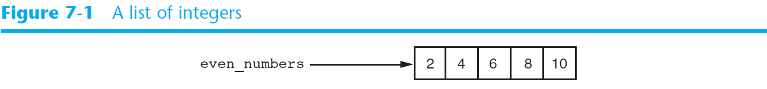
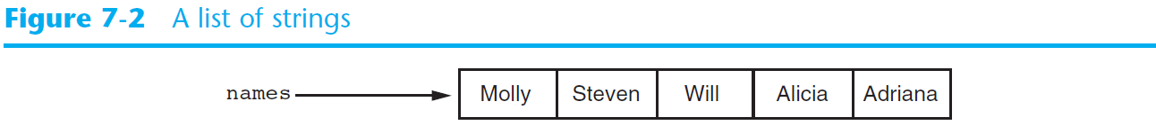
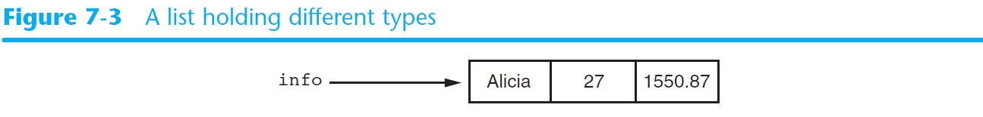
Introduction to Lists (cont’d.)

Slide 62
The Repetition Operator and Iterating over a List
Repetition operator: makes multiple copies of a list and joins them together
The * symbol is a repetition operator when applied to a sequence and an integer
Sequence is left operand, number is right
General format: list * n
Numbers=[1,2,3]*3
You can iterate over a list using a for loop
Format: for x in list:

Slide 63
Indexing
Index: a number specifying the position of an element in a list
Enables access to individual element in list
Index of first element in the list is 0, second element is 1, and n’th element is n-1
Negative indexes identify positions relative to the end of the list
The index -1 identifies the last element, -2 identifies the next to last element, etc.
An IndexError exception is raised if an invalid index is used

Slide 64
The len function
len function: returns the length of a sequence such as a list
Example: size = len(my_list)
Returns the number of elements in the list, so the index of last element is len(list)-1
Can be used to prevent an IndexError exception when iterating over a list with a loop

Slide 65
Lists Are Mutable
Mutable sequence: the items in the sequence can be changed
Lists are mutable, and so their elements can be changed
An expression such as
list[1] = new_value can be used to assign a new value to a list element
Must use a valid index to prevent raising of an IndexError exception

Slide 66
NUM_DAYS = 5
def main():
# Create a list to hold the sales for each day.
sales = [0] * NUM_DAYS
# Create a variable to hold an index.
index = 0
print('Enter the sales for each day.')
# Get the sales for each day.
while index < NUM_DAYS:
print('Day #', index + 1, ': ', sep='', end='')
sales[index] = float(input())
index += 1
# Display the values entered.
print('Here are the values you entered:')
for value in sales:
print(value)
# Call the main function.
main()

Slide 67
Concatenating Lists
Concatenate: join two things together
The + operator can be used to concatenate two lists
Cannot concatenate a list with another data type, such as a number
The += augmented assignment operator can also be used to concatenate lists
List1=[1,2,3] List2=[4,5,6] List3 = List1 + List2 (or List1 += List2)

Slide 68
List Slicing
Slice: a span of items that are taken from a sequence
List slicing format: list[start : end]
Span is a list containing copies of elements from start up to, but not including, end
If start not specified, 0 is used for start index
If end not specified, len(list) is used for end index
Slicing expressions can include a step value and negative indexes relative to end of list

Slide 69
List Slicing
Numbers = list(range(1,11))
print(Numbers[1:3]) →[2, 3]
print(Numbers[:3]) →[1, 2, 3]
print(Numbers[2:]) →[3, 4, 5, 6, 7, 8, 9, 10]
print(Numbers[1:8:2]) →[2, 4, 6, 8]

Slide 70
Finding Items in Lists with the in Operator
You can use the in operator to determine whether an item is contained in a list
General format: item in list
Returns True if the item is in the list, or False if it is not in the list
Similarly you can use the not in operator to determine whether an item is not in a list

Slide 71
# This program demonstrates the in operator
# used with a list.
def main():
# Create a list of product numbers.
prod_nums = ['V475', 'F987', 'Q143', 'R688']
# Get a product number to search for.
search = input('Enter a product number: ')
# Determine whether the product number is in the list.
if search in prod_nums:
print(search, 'was found in the list.')
else:
print(search, 'was not found in the list.')
# Call the main function.
main()

Slide 72
List Methods and Useful Built-in Functions
append(item): used to add items to a list – item is appended to the end of the existing list
index(item): used to determine where an item is located in a list
Returns the index of the first element in the list containing item
Raises ValueError exception if item not in the list

Slide 73
def main():
name_list = []
again = 'Y'
while again.upper() == 'Y':
# Get a name from the user.
name = input('Enter a name: ')
# Append the name to the list.
name_list.append(name)
# Add another one?
print('Do you want to add another name?')
again = input('y = yes, anything else = no: ')
# Display the names that were entered.
print('Here are the names you entered.')
for name in name_list:
print(name)
# Call the main function.
main()

Slide 74
def main():
# Create a list with some items.
food = ['Pizza', 'Burgers', 'Chips']
# Get the item to change.
item = input('Which item should I change? ')
try:
# Get the item's index in the list.
item_index = food.index(item)
# Get the value to replace it with.
new_item = input('Enter the new value: ')
# Replace the old item with the new item.
food[item_index] = new_item
# Display the list.
print('Here is the revised list:')
print(food)
except ValueError:
print('That item was not found in the list.')
# Call the main function.
main()

Slide 75
List Methods and Useful Built-in Functions (cont’d.)
insert(index, item): used to insert item at position index in the list
sort(): used to sort the elements of the list in ascending order
mylist.sort()
remove(item): removes the first occurrence of item in the list
reverse(): reverses the order of the elements in the list
mylist.reverse()

Slide 76
# This program demonstrates the insert method.
def main():
# Create a list with some names.
names = ['James', 'Kathryn', 'Bill']
# Display the list.
print('The list before the insert:')
print(names)
# Insert a new name at element 0.
names.insert(0, 'Joe')
# Display the list again.
print('The list after the insert:')
print(names)
# Call the main function.
main()

Slide 77
def main():
# Create a list with some items.
food = ['Pizza', 'Burgers', 'Chips']
# Display the list.
print('Here are the items in the food list:’.format(food))
# Get the item to change.
item = input('Which item should I remove? ')
try:
# Remove the item.
food.remove(item)
# Display the list.
print('Here is the revised list:’.format(food))
except ValueError:
print('That item was not found in the list.')
# Call the main function.
main()

Slide 78
List Methods and Useful Built-in Functions (cont’d.)
del statement: removes an element from a specific index in a list
General format: del list[i]
min and max functions: built-in functions that returns the item that has the lowest or highest value in a sequence
The sequence is passed as an argument
Mylist=[5, 4, 3, 2, 50, 40, 30]
max(Mylist)
min(Mylist)

Slide 79
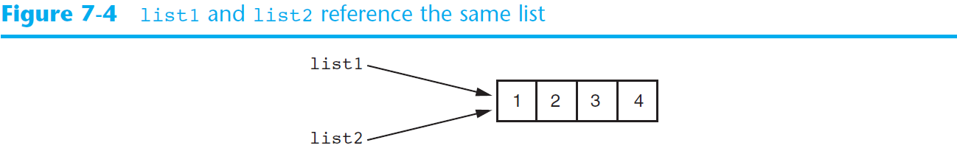
Copying Lists
>>> list1=[1,2,3,4]
>>> list2=list1
>>> print(list1)
[1, 2, 3, 4]
>>> print(list2)
[1, 2, 3, 4]
>>> list1[0]=99
>>> print(list1)
[99, 2, 3, 4]
>>> print(list2)
[99, 2, 3, 4]
List1 and list2 share the same memory
Like the pointer concept

Slide 80
Copying Lists
To make a copy of a list you must copy each element of the list
Two methods to do this:
Creating a new empty list and using a for loop to add a copy of each element from the original list to the new list
Creating a new empty list and concatenating the old list to the new empty list
>>> list1=[1,2,3,4]
>>> list2=[]
>>> for item in list1:
... list2.append(item)
>>> list1=[1,2,3,4]
>>> list3=[]+list1
>>> print(list3)
[1, 2, 3, 4]

Slide 81
Processing Lists
List elements can be used in calculations
To calculate total of numeric values in a list use loop with accumulator variable
To average numeric values in a list:
Calculate total of the values
Divide total of the values by len(list)
List can be passed as an argument to a function

Slide 82
# This program calculates the total of the values
# in a list.
def main():
# Create a list.
numbers = [2, 4, 6, 8, 10]
# Create a variable to use as an accumulator.
total = 0
# Calculate the total of the list elements.
for value in numbers:
total += value
# Display the total of the list elements.
print('The total of the elements is', total)
# Call the main function.
main()

Slide 83
# This program calculates the average of the values
# in a list.
def main():
# Create a list.
scores = [2.5, 7.3, 6.5, 4.0, 5.2]
# Create a variable to use as an accumulator.
total = 0.0
# Calculate the total of the list elements.
for value in scores:
total += value
# Calculate the average of the elements.
average = total / len(scores)
# Display the total of the list elements.
print('The average of the elements is', average)
# Call the main function.
main()

Slide 84
# This program uses a function to calculate the
# total of the values in a list.
def main():
# Create a list.
numbers = [2, 4, 6, 8, 10]
# Display the total of the list elements.
print('The total is', get_total(numbers))
def get_total(value_list):
# Create a variable to use as an accumulator.
total = 0
# Calculate the total of the list elements.
for num in value_list:
total += num
# Return the total.
return total
# Call the main function.
main()

Slide 85
Processing Lists (cont’d.)
A function can return a reference to a list

Slide 86
# This program reads a file's contents into a list.
def main():
# Open a file for reading.
infile = open('cities.txt', 'r')
# Read the contents of the file into a list.
cities = infile.readlines()
# Close the file.
infile.close()
# Strip the \n from each element.
index = 0
while index < len(cities):
cities[index] = cities[index].rstrip('\n')
index += 1
# Print the contents of the list.
print(cities)
# Call the main function.
main()

Slide 87
# This program saves a list of numbers to a file.
def main():
# Create a list of numbers.
numbers = [1, 2, 3, 4, 5, 6, 7]
# Open a file for writing.
outfile = open('numberlist.txt', 'w')
# Write the list to the file.
for item in numbers:
outfile.write(str(item) + '\n')
# Close the file.
outfile.close()
# Call the main function.
main()

Slide 88
# This program reads numbers from a file into a list.
def main():
# Open a file for reading.
infile = open('numberlist.txt', 'r')
# Read the contents of the file into a list.
numbers = infile.readlines()
# Close the file.
infile.close()
# Convert each element to an int.
index = 0
while index < len(numbers):
numbers[index] = int(numbers[index])
index += 1
# Print the contents of the list.
print(numbers)
# Call the main function.
main()

Slide 89
Two-Dimensional Lists
Two-dimensional list: a list that contains other lists as its elements
Also known as nested list
Common to think of two-dimensional lists as having rows and columns
Useful for working with multiple sets of data
To process data in a two-dimensional list need to use two indexes
Typically use nested loops to process

Slide 90
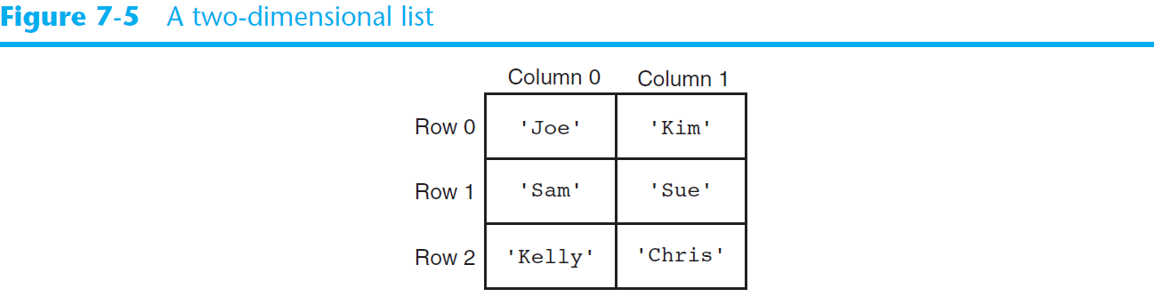
Two-Dimensional Lists (cont’d.)

Slide 91
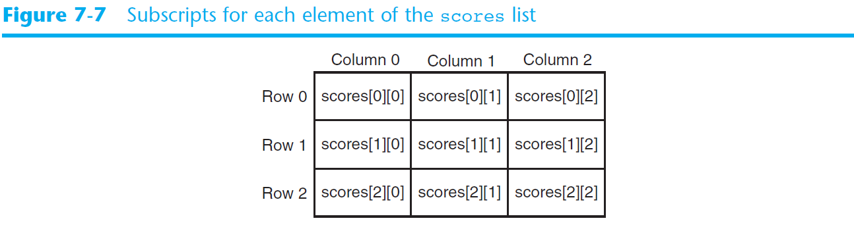
Two-Dimensional Lists (cont’d.)

Slide 92
# This program assigns random numbers to
# a two-dimensional list.
import random
# Constants for rows and columns
ROWS = 3
COLS = 4
def main():
# Create a two-dimensional list.
values = [[0, 0, 0, 0],
[0, 0, 0, 0],
[0, 0, 0, 0]]
# Fill the list with random numbers.
for r in range(ROWS):
for c in range(COLS):
values[r][c] = random.randint(1, 100)
# Display the random numbers.
print(values)
# Call the main function.
main()

Slide 93
Real list in python
In actually, no dimension concept in python
You can put everything and anything to the list

Slide 94
Tuples
Tuple: an immutable sequence
Very similar to a list
Once it is created it cannot be changed
Format: tuple_name = (item1, item2)
Tuples support operations as lists
Subscript indexing for retrieving elements
Methods such as index
Built in functions such as len, min, max
Slicing expressions
The in, +, and * operators

Slide 95
Tuples (cont’d.)
Tuples do not support the methods:
append
remove
insert
reverse
sort

Slide 96
Tuples (cont’d.)
Advantages for using tuples over lists:
Processing tuples is faster than processing lists
Tuples are safe
Some operations in Python require use of tuples
list() function: converts tuple to list
tuple() function: converts list to tuple

Slide 97
Summary
This chapter covered:
Lists, including:
Repetition and concatenation operators
Indexing
Techniques for processing lists
Slicing and copying lists
List methods and built-in functions for lists
Two-dimensional lists
Tuples, including:
Immutability
Difference from and advantages over lists

Slide 98
Week 03 on-site assignment
Write a program to store student’s name and score
Support add, delete, modify functionalities
Restore the execution results to a file

